Slide 1
SPARQL Tutorial
By: Anderson Wong

Slide 2

What is SPARQL?
SPARQL (SPARQL Protocol and RDF Query Language) is a query language for Linked Open Data or RDF triplestores
Like SQL, SPARQL can be used to retrieve and modify data in graph databases
SPARQL queries consist of a set of triple patterns (subject, predicate, object)

Slide 3
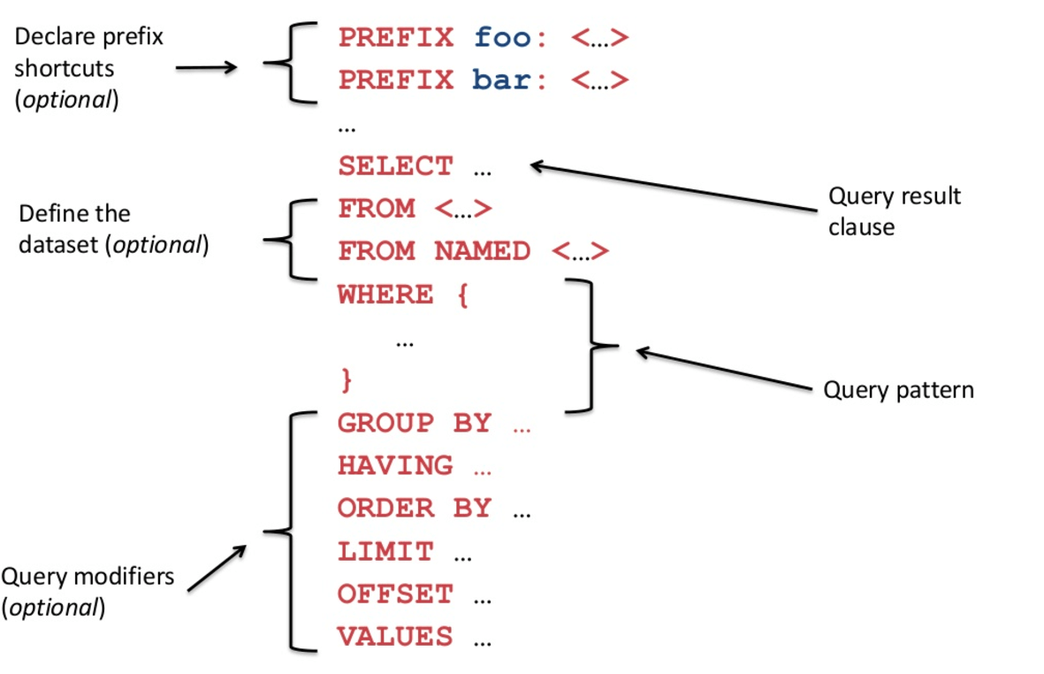
SPARQL Queries
Use "PREFIX" to declare a namespace prefix
Prefixes help simplify queries
e.g. You can write "example:YourClass" instead of http://example.org/YourClass
There are different types of SPARQL queries
e.g. ASK, SELECT, CONSTRUCT
Optional modifiers can be used to sort, limit, etc. query results

Slide 4
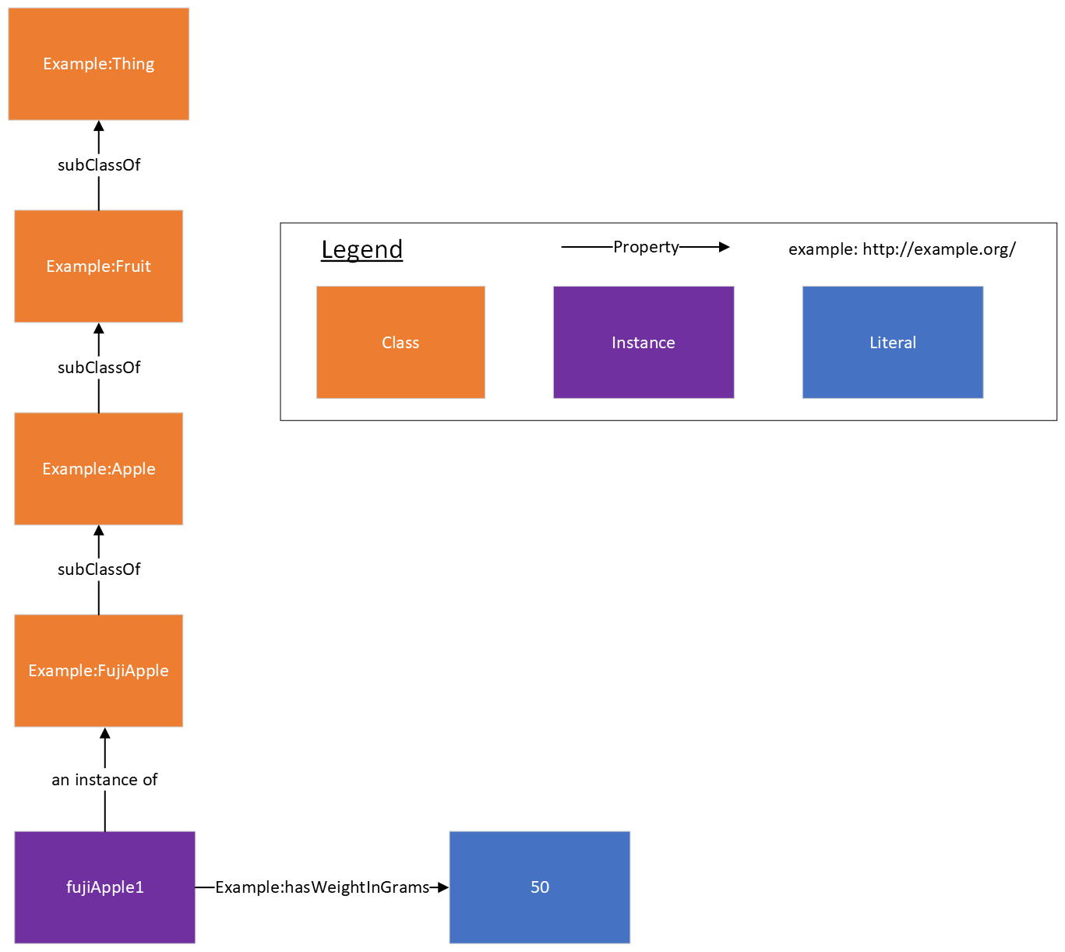
Example Data

Slide 5
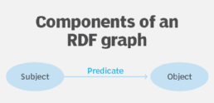
SPARQL Example 1 SELECT
SELECT queries can be used to retrieve data from a knowledge graph
Variables have a "?" preceding the variable name
Add a "." at the end of a triple statement for syntax
To declare the "example" prefix use: PREFIX example: <http://example.org/>
To find the weight of fujiApple1 use: SELECT ?weight WHERE{ example:fujiApple1 example:hasWeightInGrams ?weight. }
The above SELECT query returns the value(s) of the "?weight" variable where: The subject is "example:fujiApple1" The predicate is "example:hasWeightInGrams" The object is the variable "?weight"

Slide 6
SPARQL Example 2 SELECT
To find the weight of all instances of FujiApple use: SELECT ?fujiapple ?weight WHERE{ ?fujiapple a example:FujiApple; example:hasWeightInGrams ?weight. }
The above query would return a list of FujiApple instances and their corresponding weight value
The "a" in the query means "instance of"
The ";" means that the subject (?fujiapple in this case) is reused with the predicate and object (example:hasWeightInGrams and ?weight) on the next line.
In other words, it is the same as: ?fujiapple a example:FujiApple. ?fujiapple example:hasWeightInGrams ?weight.

Slide 7
SPARQL Example 3 ASK
ASK queries check whether there is a triple in the knowledge graph that matches the query and returns a Boolean TRUE if there is or a Boolean FALSE if there is not.
Check whether there is an instance of FujiApple named "fujiApple498": ASK WHERE{ example:fujiApple498 a example:FujiApple. }
The above query would return a Boolean TRUE if there is an instance of FujiApple named "fujiApple498". Otherwise, it would return a Boolean FALSE.

Slide 8
SPARQL Example 4 Implicit vs. Explicit
Implicit vs Explicit: SELECT ?class WHERE{ ?class rdfs:subClassOf example:Thing }
If implicit, this query would return the Fruit, Apple, and FujiApple classes because Fruit is a subclass of Thing, Apple is a subclass of Fruit, and FujiApple is a subclass of Apple
This implies that all 3 classes are subclasses of example:Thing
If explicit, this query would return only the Fruit class because only the Fruit class is explicitly defined to be a subclass of example:Thing.
The Apple class is explicitly defined as a subclass of Fruit and FujiApple is explicitly defined as a subclass of Apple thus, neither FujiApple nor Apple are explicit subclasses of Thing.
Use "FROM NAMED <http://www.ontotext.com/implicit>" or "FROM NAMED <http://www.ontotext.com/explicit>" to query implicit or explicit statements respectively.
You can add the FROM NAMED line below the SELECT line

Slide 9
Further Reading for Introductory SPARQL
What is SPARQL:
https://www.ontotext.com/knowledgehub/fundamentals/what-is-sparql/#:~:text=%EF%BB%BF,can%20be%20mapped%20to%20RDF.
SPARQL Tutorial:
https://www.wikidata.org/wiki/Wikidata:SPARQL_tutorial
SPARQL Modifiers:
https://en.wikibooks.org/wiki/SPARQL/Modifiers#:~:text=The%20five%20modifiers%20are%20GROUP,.%20and%20OFFSET%20...%20.

Slide 10
Further Reading for Introductory SPARQL
Official SPARQL Documentation:
https://www.w3.org/TR/rdf-sparql-query/
Another SPARQL Tutorial:
https://jena.apache.org/tutorials/sparql.html

Slide 11
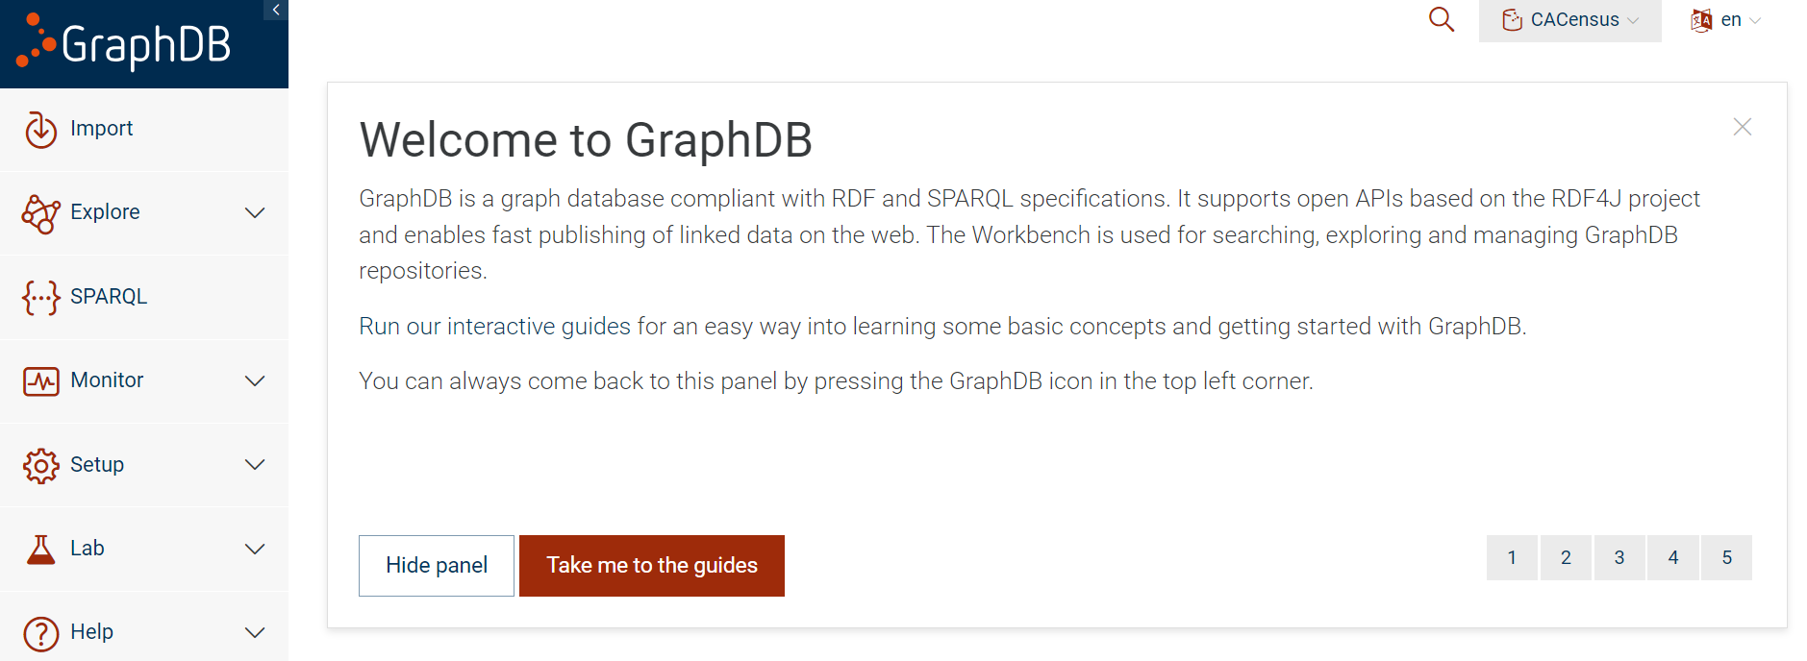
Accessing the City Digital Twin Knowledge Graph
The knowledge graph can be accessed using this link: http://ec2-3-97-59-180.ca-central-1.compute.amazonaws.com:7200/
You can experiment with SPARQL queries by clicking on the SPARQL section in the sidebar.

Slide 12
Example Queries
Return a list of neighbourhood names
PREFIX rdfs: <http://www.w3.org/2000/01/rdf-schema#> PREFIX uoft: <http://ontology.eil.utoronto.ca/tove/cacensus#> SELECT ?areaname WHERE{ ?area a toronto:Neighbourhood; rdfs:comment ?areaname. }

Slide 13
Example Queries
Return a list of wards and their geospatial coordinates (in WKT format) in alphabetical order by ward name
PREFIX rdfs: <http://www.w3.org/2000/01/rdf-schema#> PREFIX toronto: <http://ontology.eil.utoronto.ca/Toronto/Toronto#> PREFIX iso50871: <http://ontology.eil.utoronto.ca/5087/1/SpatialLoc/> PREFIX geo: <http://www.opengis.net/ont/geosparql#> SELECT ?areaname ?coordinates WHERE{ ?area a toronto:Ward; rdfs:comment ?areaname; iso50871:hasLocation ?arealocation. ?arealocation geo:asWKT ?coordinates. } ORDER BY ?areaname

Slide 14
Example Queries
Return the number of Aboriginal people (2016 Census data) in neighborhood77 (Waterfront Communities-The Island) and neighborhood76 (Bay Street Corridor) and order the results from greatest number of Aboriginal people to least
PREFIX uoft: <http://ontology.eil.utoronto.ca/tove/cacensus#> PREFIX toronto: <http://ontology.eil.utoronto.ca/Toronto/Toronto#> PREFIX iso21972: <http://ontology.eil.utoronto.ca/ISO21972/iso21972#> SELECT ?neighborhood (sum(?value) as ?sumvalue) WHERE{ ?neighborhood a toronto:Neighbourhood; toronto:hasCensusTract ?censustract. FILTER (?neighborhood IN (toronto:neighborhood77, toronto:neighborhood76) ) ?aboriginal a uoft:AboriginalIdentity2016; uoft:hasLocation ?censustract; iso21972:value ?measure. ?measure iso21972:numerical_value ?value. } GROUP BY ?neighborhood ORDER BY DESC(?sumvalue)

Slide 15
Two Content Layout with Table
First bullet point here
Second bullet point here
Third bullet point here
 | Group A | Group B
Class 1 | 82 | 95
Class 2 | 76 | 88
Class 3 | 84 | 90

Slide 16
Two Content Layout with SmartArt
Group A
Task 1
Task 2
Group B
Task 1
Task 2
Group C
Task 1
First bullet point here
Second bullet point here
Third bullet point here

